Slide 1
AeroCareers.net
Reach Higher Altitudes In Aerospace

Slide 2

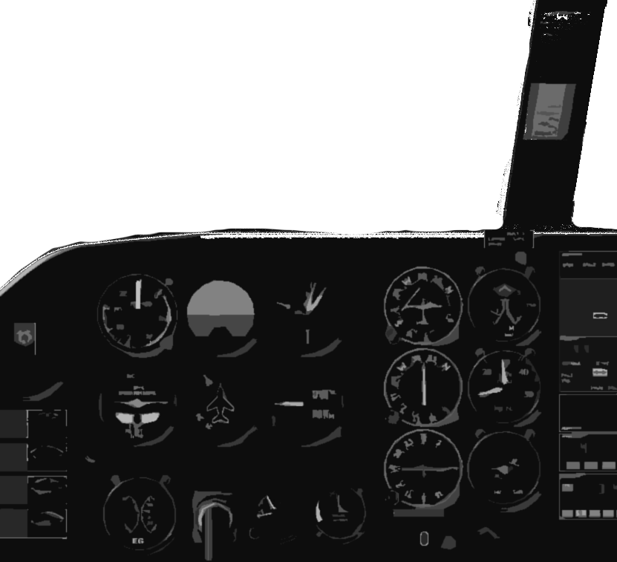
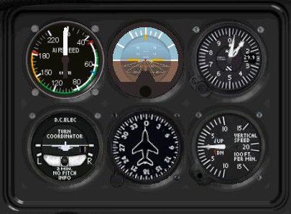
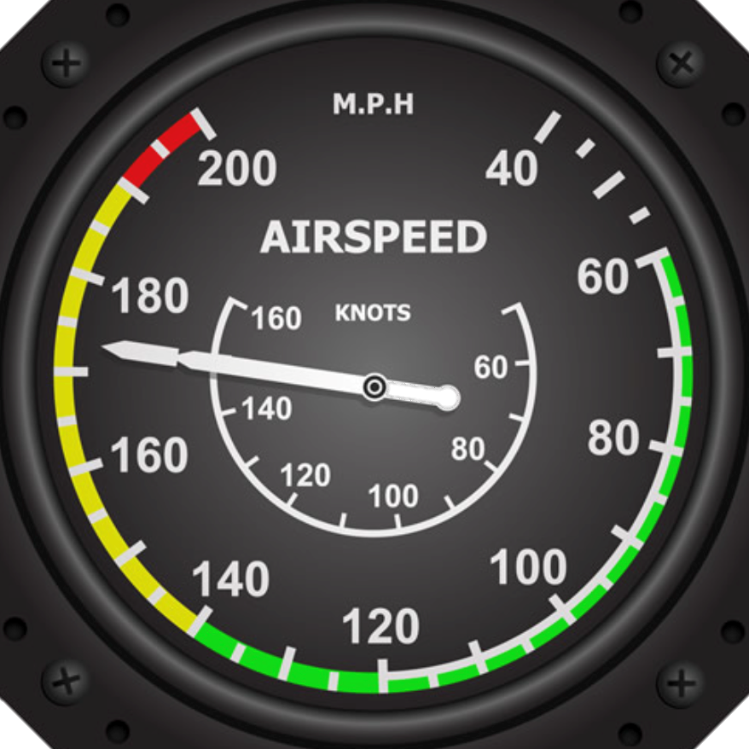
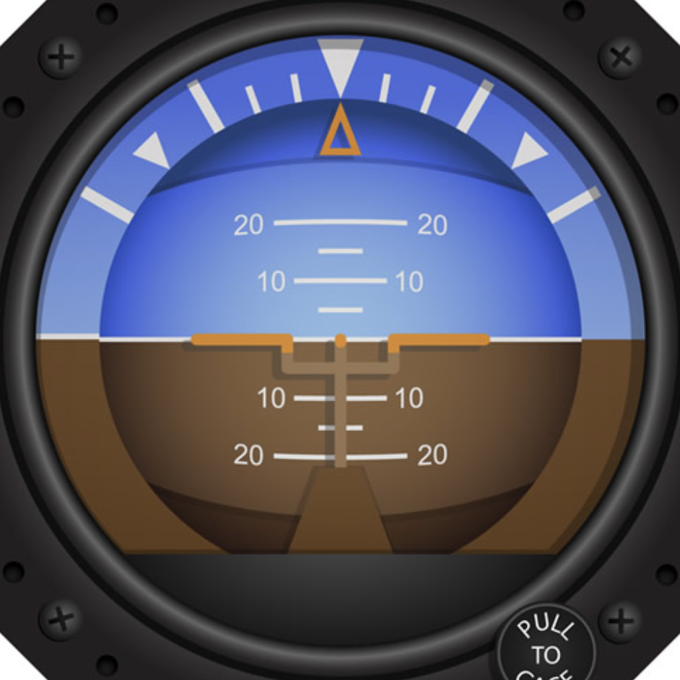
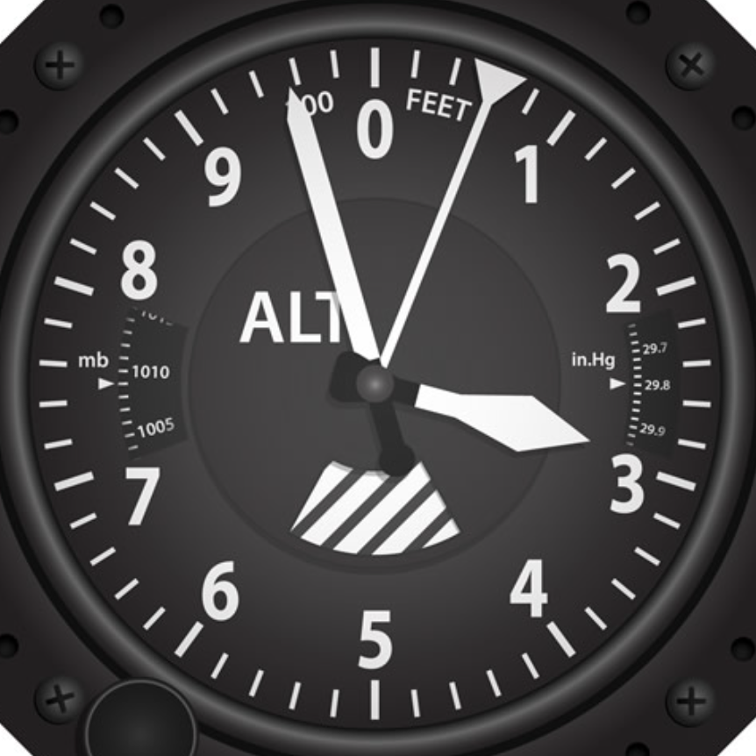
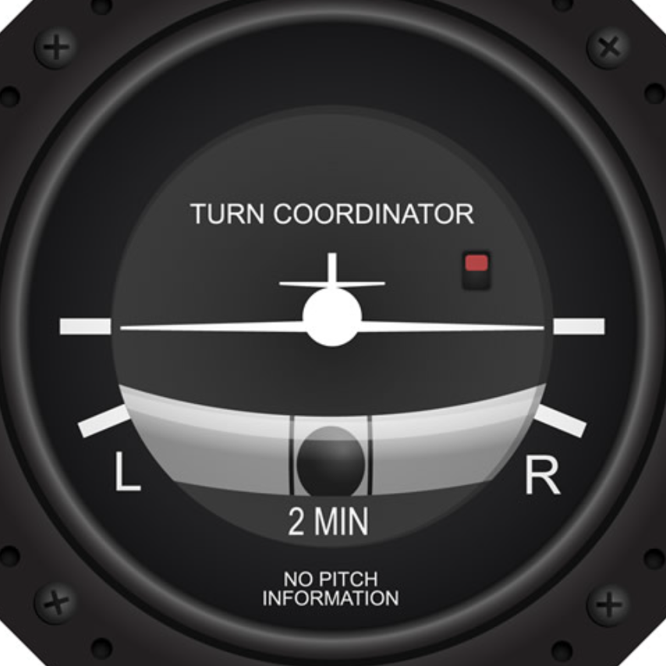

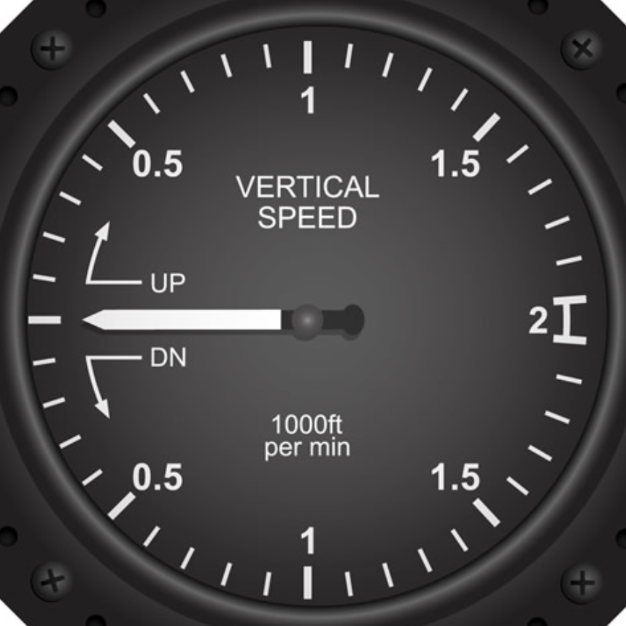
Why Aerospace?
There are many great reasons to start or continue an exciting career in the aerospace field.
1
2
6
The 'six pack' of aircraft instruments installed in every aircraft, provide critical flight information to the pilot. Each of these six instruments offer different information to help a pilot navigate their course, similarly, each of these can be used as a reference for your own career flight plan.
4
3
5

Slide 3

Airspeed
1
Airspeed
Even though aircraft require a minimum speed to take off, many careers in the aerospace industry can be started from the ground up!
With a range of opportunities from entry level to experienced, including scholarships, and options for veterans, there are resources for everyone to get their career off the ground.
Return to
‘Why Aerospace’

Slide 4
Attitude
2
Attitude
The attitude indicator shows the aircraft pitch and roll giving the pilot a relative position to the earth’s horizon.
A career in the aerospace industry requires having the right mental attitude. Thinking outside the box, collaborating with others, and solving complex problems all require the right attitude to be successful.
Return to
‘Why Aerospace’

Slide 5
Heading
3
Heading
The aerospace industry has something for everyone, including the opportunity to own your own business, all that is needed is the right path to success.
Aircraft commonly fly a predetermined heading like following a compass on a map. By following some of the exciting aerospace career paths, you will be heading for success!
Return to
‘Why Aerospace’

Slide 6
Turn
4
Turn
The turn coordinator ensures smooth changes in the aircraft heading.
With prior experience in another profession or even a different field of study, there is plenty of opportunity to transition into a career in aerospace. Veterans have unique resources to help turn their experiences in to opportunities in aerospace.
Return to
‘Why Aerospace’

Slide 7
Vertical
Speed
5
Vertical Speed
Just as aircraft are able to climb to higher altitudes, the aerospace field has many growth opportunities for people new to the industry as well as those with experience.
With opportunities to advance your education and earn additional industry certification, the extra thrust will help your career soar!
Return to
‘Why Aerospace’

Slide 8

Altitude
6
Altitude
Careers in aerospace can reach higher altitudes with preparation and the right plan.
Career outlook
Understanding your passion and interests
Skills and abilities
How to get started
Committing to your educational journey
Return to
‘Why Aerospace’

Slide 9



Different Types of Aviation
Business &
General Aviation
Commercial
Military/ Defense

Slide 10

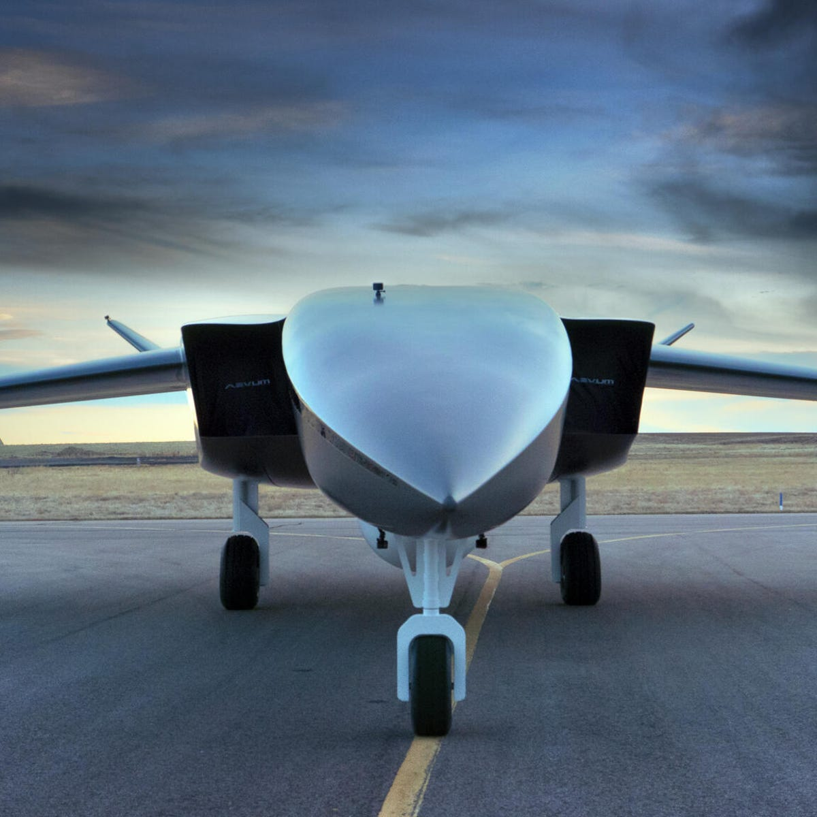
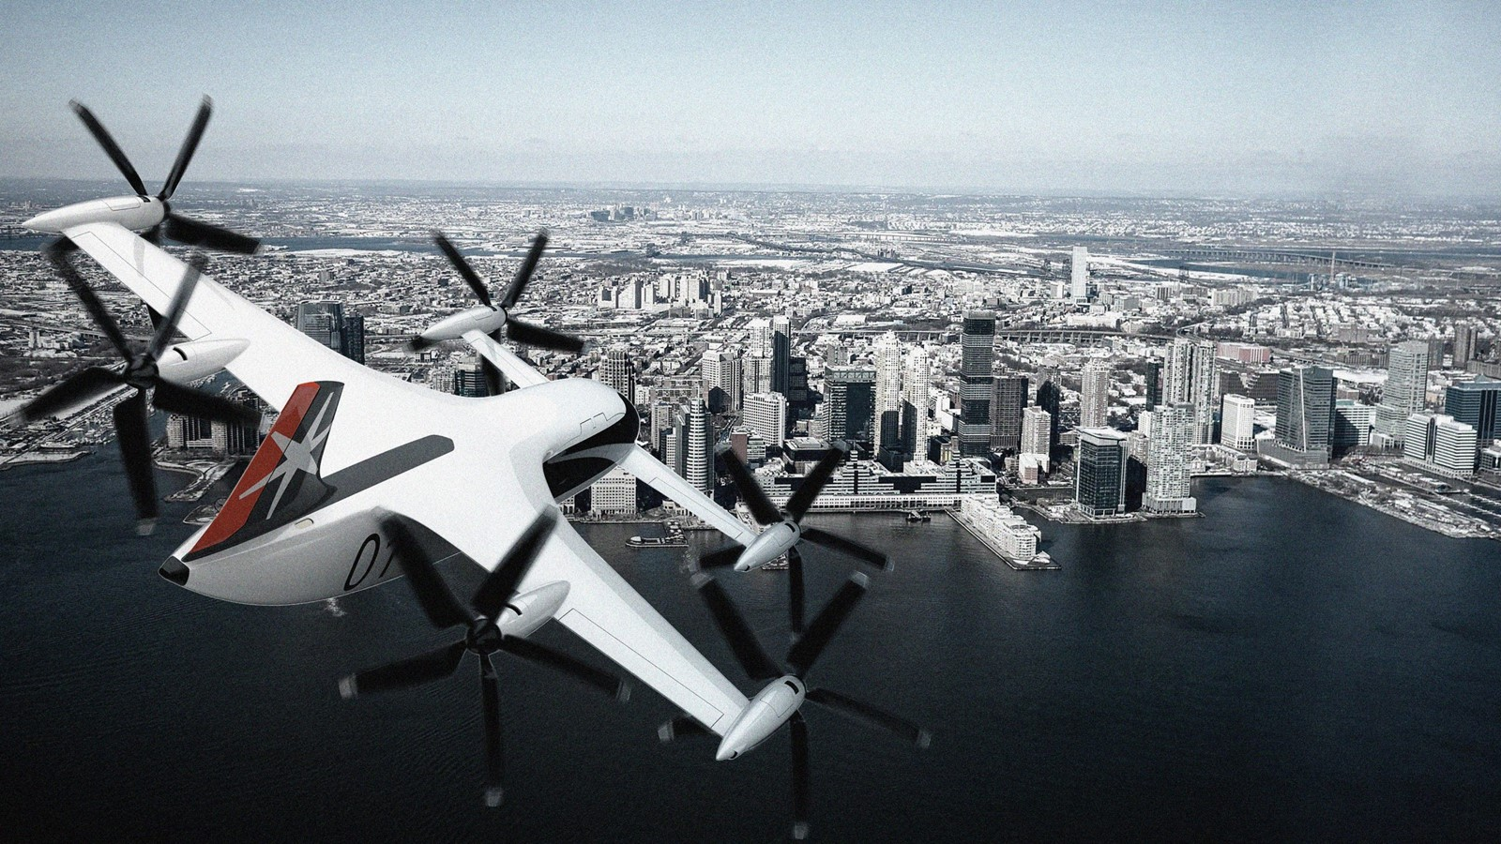


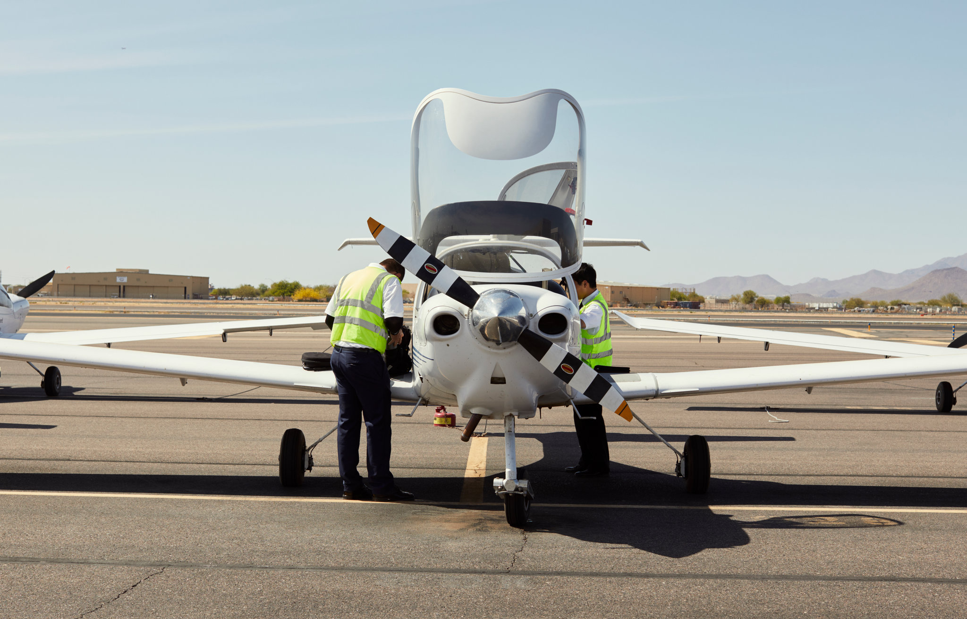
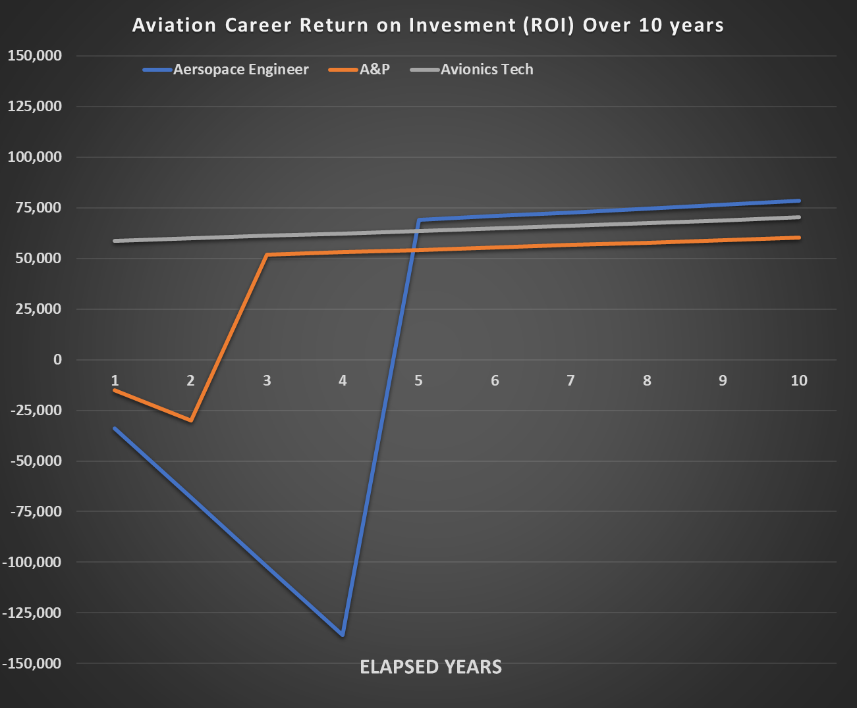
Aviation in the next 20 years
Drones
(Flight and maintenance)
Advanced Air Mobility
Electric Propulsion
Artificial Intelligence
Still a need for legacy aircraft skills and abilities
Aviation Career Return of Investments (ROI) Over 10 Years
  Maintenance
  Modifications
  Restorations
Notes:
https://www.mynextmove.org/explore/ip

Slide 11
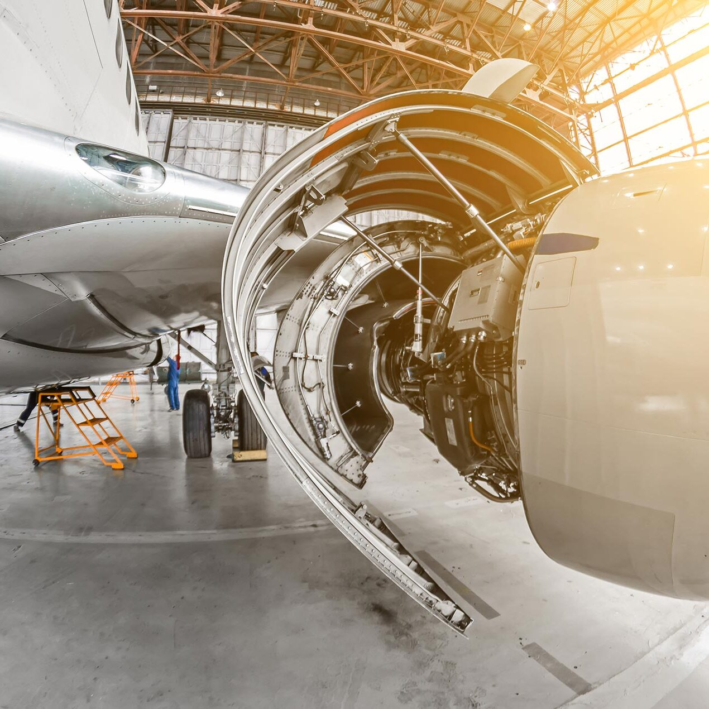
Career Outlook
PAY: MEDIAN ANNUAL WAGES AS OF MAY’22
JOB OUTLOOK
01
01
Avionics technicians
$75,450
6%
Overall employment of aircraft and avionics equipment mechanics and technicians, commercial pilots and aerospace engineers is projected to grow 6 percent from 2021 to 2031, about as fast as the average for
all occupations
02
Aircraft Mechanics and Service Technicians
$70,010
03
Aerospace Engineers
$126,880
02
Job growth is steady for all major aviation careers through the
next decade
04
Commercial Pilot
$103,910
Notes:
https://www.mynextmove.org/explore/ip

Slide 12
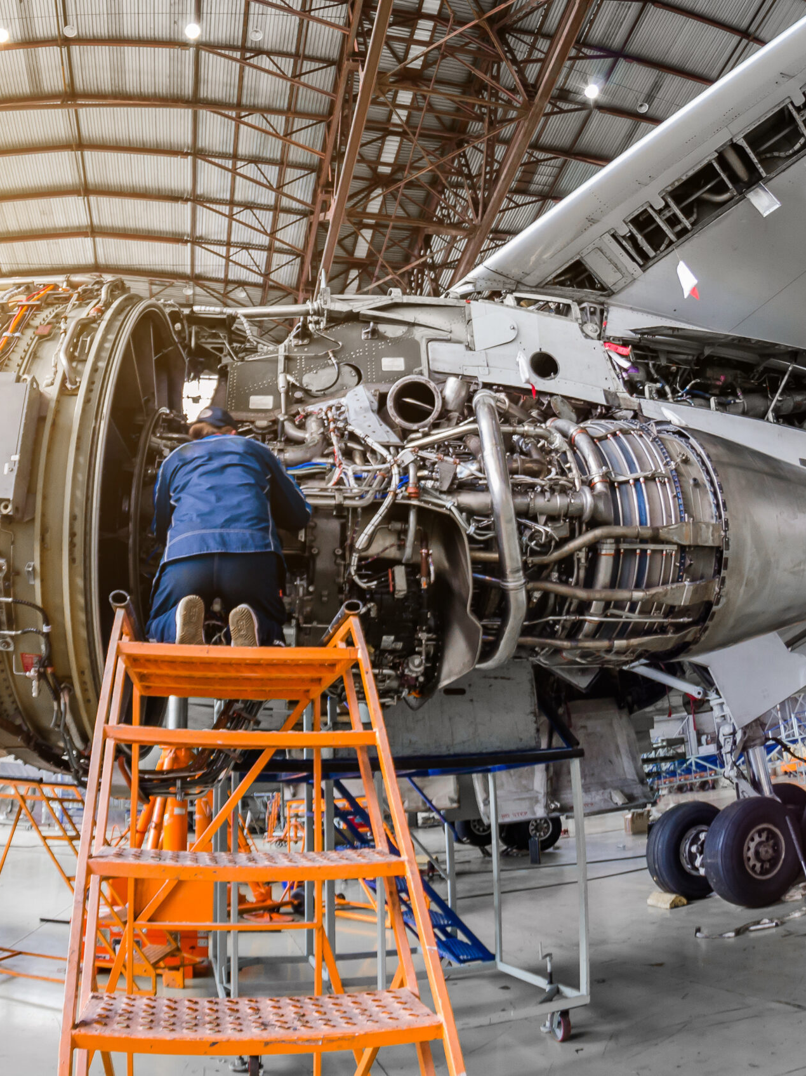
Career Outlook
General Aviation Manufacturing
31,900
73,600
full- and part-time workers were employed in the manufacture of general aviation aircraft in 2018
workers were employed in the manufacture of components (avionics, instruments, etc.)
for general aviation aircraft
Сombined direct employment impact of 105,500 jobs
These workers earned $11.0 billion in labor income in 2018,
an average of $104,389 per job

Slide 13
Career Outlook
General Aviation Operation and Maintenance
additional 168,000
workers were employed in jobs directly related to the operation and maintenance of general aviation aircraft, including jobs in flight training, nonscheduled air transportation, scenic and sightseeing, and support activities for air transportation (such as fixed base operators and other maintenance and repair facilities)
These workers earned an average of $86,277 per job in 2018

Slide 14
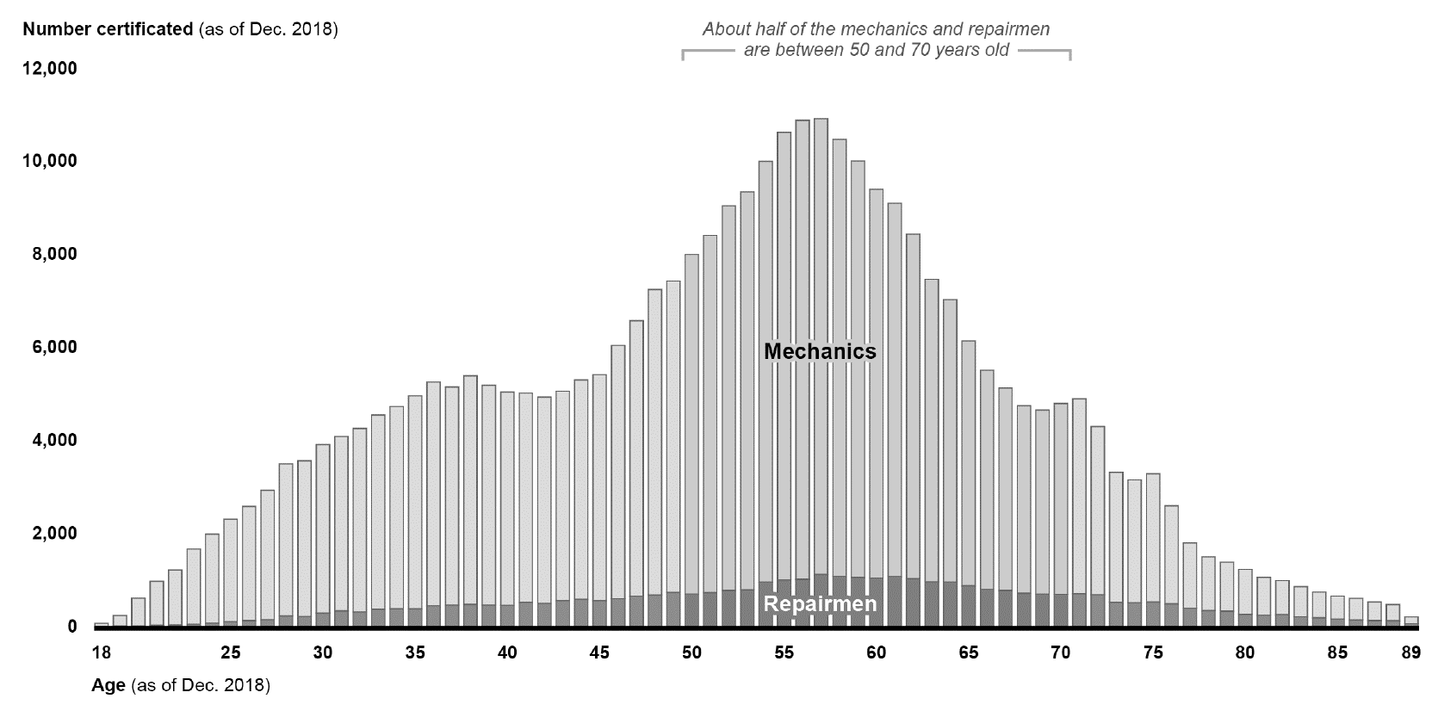
Where the jobs are
Total impact of General Aviation, Top-10 States, 2018
[Ranked by Total Employment Impact, Dollar Amounts in Billions]
State | Total Jobs ⁽¹⁾ | Total Labor Income ⁽²⁾ | Total Output | Total Contribution to GDP
California | 148,300 | $11,3 | $32,8 | $18,5
Florida | 94,900 | $6,4 | $20,8 | $10,8
Texas | 90,100 | $5,5 | $14,3 | $9,0
Georgia | 56,700 | $3,8 | $17,1 | $6,1
Ohio | 43,700 | $3,0 | $9,1 | $5,0
New York | 43,200 | $3,4 | $9,5 | $5,4
Illinois | 41,800 | $2,2 | $8,3 | $4,3
Arizona | 40,200 | $1,9 | $5,7 | $3,1
Kansas | 37,800 | $2,6 | $8,9 | $3,7
Pennsylvania | 32,900 | $2,9 | $8,6 | $3,8
About half of the mechanics
and repairmen are between
50 and 70 years old
Age Distribution of Federal Aviation Administration (FAA) Certificated Mechanics and Repairmen as of December 2018

Slide 15

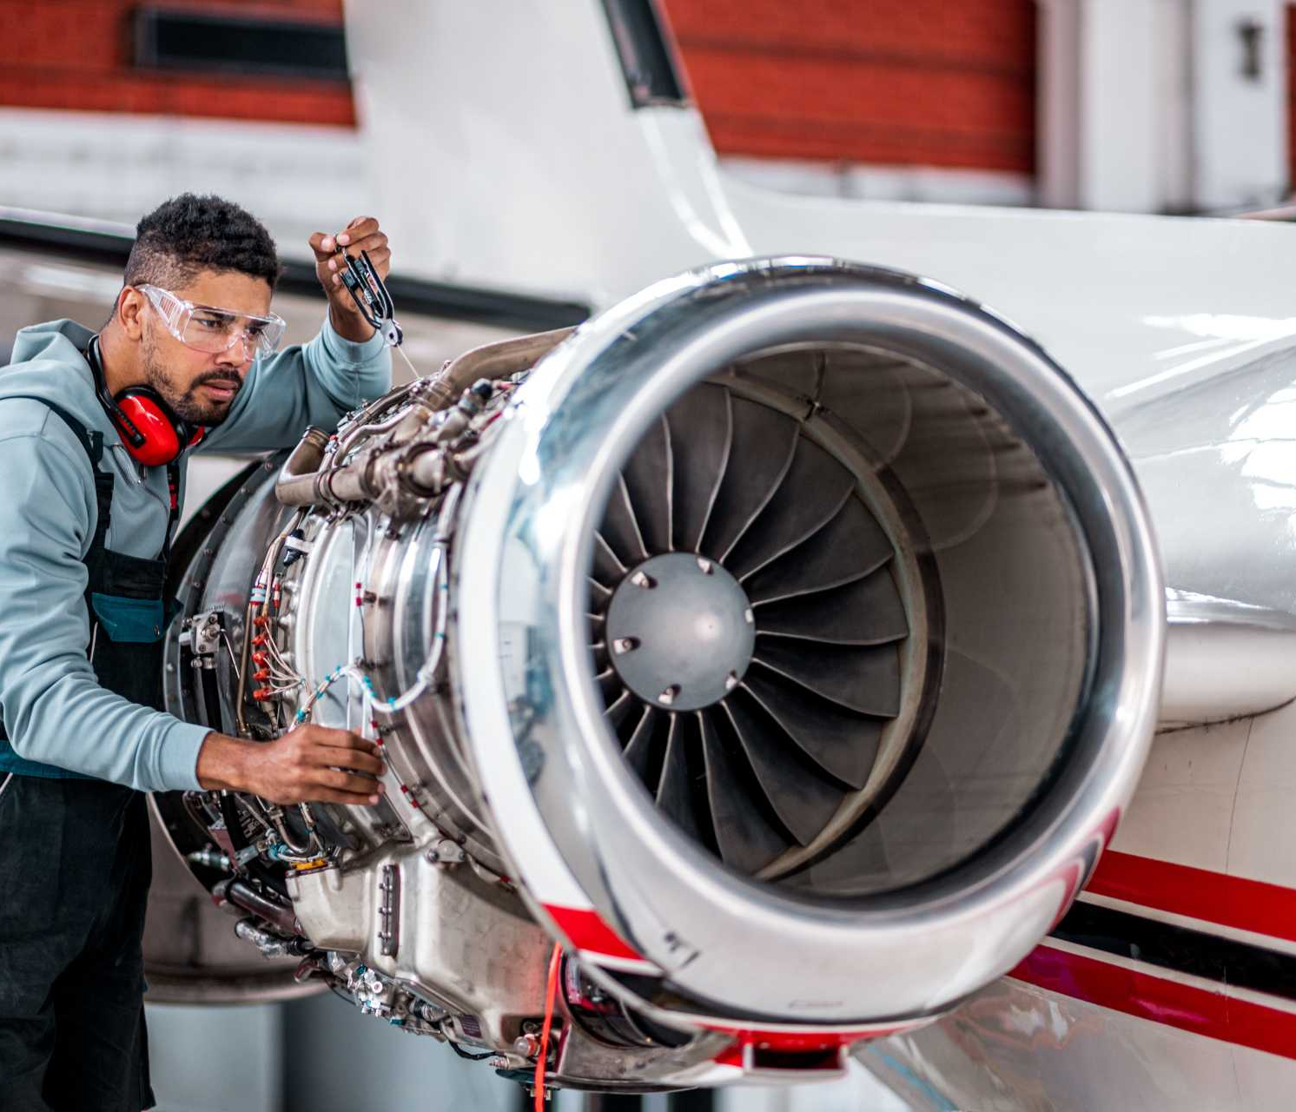
Plenty of new opportunities
Z
About half of the mechanics
and repairmen are between
50 and 70 years old
Age Distribution of Federal Aviation Administration (FAA) Certificated Mechanics and Repairmen as of December 2018

Slide 16




Military Opportunities
Z
Multiple aviation career paths in each branch of service through various military occupational specialty (MOS) or rating
Sought after skills in civil aviation along with reputation for being disciplined and reliable
About half of the mechanics
and repairmen are between
50 and 70 years old
Age Distribution of Federal Aviation Administration (FAA) Certificated Mechanics and Repairmen as of December 2018
Educational assistance available for continuing education
Opportunity to return home

Slide 17
What fuels your aviation career?
ARE YOUR INTERESTS?
DO YOU VALUE?
01
01
Realistic
Support
Designing, building, or repairing of equipment, materials, or structures, engaging in physical activity, or working outdoors.
Management that stands with and supports employees.
02
02
Relationships
Investigative
Provide service to others and work with co-workers in a friendly
non-competitive environment.
Studying and researching
03
03
Conventional
Achievement
Following procedures and regulations to organize information or data, typically in a business setting.
Results oriented gaining a feeling of accomplishment.
Notes:
https://www.mynextmove.org/explore/ip

Slide 18


What fuels your aviation career?
Z
Is this your style?
Attention to Detail
Analytical Thinking
being careful about detail and thorough in completing work tasks
analyzing information and using logic to address work-related issues and problems
Integrity
being honest and ethical
Achievement/Effort
Dependability
establishing and maintaining challenging goals and exerting effort toward mastering tasks
being reliable, responsible, and dependable, and fulfilling obligations
Aerocareers.net
18

Slide 19






What fuels your aviation career?
Z
Information Technology
Mechanically
Inclined
Communication
Problem Solving
SKILLS AND ABILITIES
Electrical
Aptitude
Wiring And
Schematics

Slide 20

Why You’ll Love A Job in Aviation
Learn and use the latest technology
Opportunity to own your own company
Learn to fly
Solve complex problems
Travel
Impact the world in a positive way
No two days are the same
Great work life balance
Not a desk job
Hands-on work
Aerocareers.net
20

Slide 21
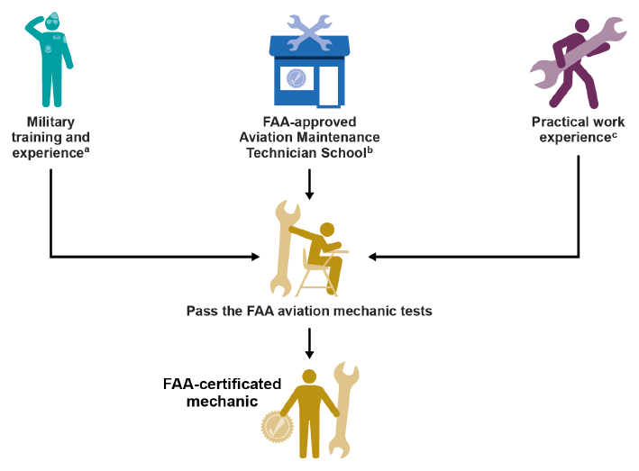
How to start a career
01
PATHWAYS TO FEDERAL AVIATION ADMINISTRATION (FAA) CERTIFICATION FOR MECHANICS
Internships
While you are in high school
Line service at local airport aircraft handling and refueling
Work to earn your A&P license
02
Direct hire
No experience required
Aircraft or avionics manufacturers
Avionics repair stations
03
Community/Technical College/University
Part 147 A&P program
Pilot training
Engineering
Notes:
https://www.mynextmove.org/explore/ip

Slide 22






Career Pathways for Federal Aviation Administration (FAA) Certificated Mechanics, 2015 through 2018
10%
62%
28%
Military training and experience
FAA-approved Aviation Maintenance Technical School
Practical work experience
Note: FAA certificated 25,543 mechanics from 2015 through 2018.
Notes:
https://www.mynextmove.org/explore/ip

Slide 23

What you can do TODAY
To Grow Your Aviation Career
Earn your pilot's license
Earn your Part 107 license for UAS (drones)
Visit a Part 147 school Aviation Maintenance Technician school
Visit aea.net/jobs to learn about the needs of the industry
Job shadow an avionics technician or
Earn your AET certification
Explore aviation channels on social media and YouTube
Drones
(Flight and maintenance)
Advanced Air Mobility
Electric Propulsion
Artificial Intelligence
Still a need for legacy aircraft skills and abilities
  Maintenance
  Modifications
  Restorations

Slide 24
Start Today or Invest in Your Career
Return on investment (ROI) over 10 years of employment
Avionics Tech* $640,000
A&P $419,000
Engineer $134,000
*entry level avionics installer after completing high school aviation program or starting apprenticeship
Drones
(Flight and maintenance)
Advanced Air Mobility
Electric Propulsion
Artificial Intelligence
Still a need for legacy aircraft skills and abilities
  Maintenance
  Modifications
  Restorations

Slide 25
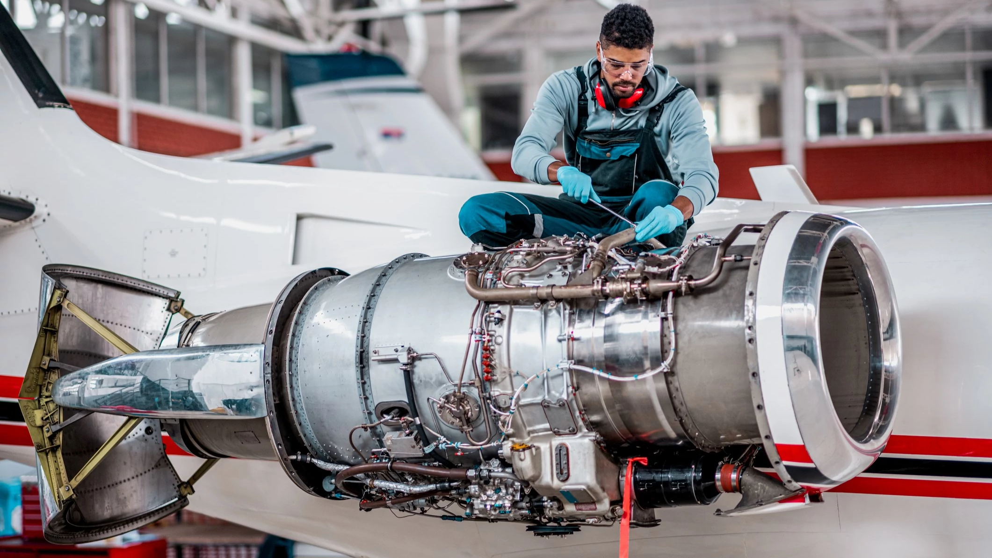

aerocareers.net
To learn more about other careers in aerospace visit www.aerocareers.net
Have questions on how to stay aloft in the aerospace field? Visit our FAQ page to learn more about the industry.
Share the high-flying opportunities found in the aerospace field with someone else? Visit our Educators page for more resources and follow us on social media.
Aviation Career Return of Investments (ROI) Over 10 Years
Aerocareers.net
25

